Slide 1
Intermediate RNA-seq data analysis using R
Michela Traglia, Min-Gyoung Shin
Bioinformatics Core, GIDB
September 29, 2023

Slide 2
Upcoming workshop at Gladstone:
Oct 3 | Machine Learning for biologists - register
Oct 9-10 | Linear mixed effects models - register
Oct 16-17 | Single Cell RNA-seq (3 sessions)- register
Oct 31 | Introduction to pathway analysis - register
Winter workshops schedule coming soon - Data Science Training Program

Slide 3
Requirements for the demo
Please install the following library in Rstudio
install.packages("magrittr")
install.packages("statmod")
install.packages("tidyverse")
install.packages("ggplot2")
install.packages("BiocManager")
BiocManager::install("edgeR")
BiocManager::install("org.Mm.eg.db")
Verify the installation:
library(magrittr)
library(statmod)
library(tidyverse)
library(ggplot2)
library(edgeR)
library(library(edgeR))

Slide 4
Materials for this workshop
Please download the compressed file 2023Sept_intermediatRNAseq.zip
Double click on the file, the unzipped folder includes:
This presentation with concepts
Hands-on session files:
- handson.R
- targets.txt
- DE_resutls.txt
- GSE60450_Lactation-GenewiseCounts.txt.gz

Slide 5
Introductions
Min-Gyoung Shin
Bioinformatician II
Michela Traglia
Statistician III

Slide 6
Workshop outline
Intro to a real experiment Approach for Differentially Expressed Gene analysis: edgeR
Filtering genes
Normalization
Demo I
Exploratory visualization: MDS – PCA
Fit the model for DEG
Compare groups and visualize the DEG
Demo II

Slide 7
Assumed background
Familiarity with R and RStudio
Familiarity with RNA-seq protocol
Familiarity with basic concepts of statistics and hypothesis testing

Slide 8
Poll 1
How familiar are you with the RNAseq pipeline?
I attended the Introduction to RNAseq workshop last week but I never run the pipeline
I attended other courses/ read papers and pipeline documentation only
I have experience running at least one RNAseq pipeline

Slide 9


RNA-seq - analysis workflow
Biological samples
Library preparation
Sequencer: Reads Fastq
Quality check
FastQC
Trimming
cutadapt
Quality check
FastQC
Alignment/Mapping
STAR
Quality check
Counting Reads
featureCounts
Quality check
Notes:
See Intro to RNA-seq workshop materials at https://github.com/gladstone-institutes/Bioinformatics-Workshops/blob/master/intro-rna-seq/

Slide 10
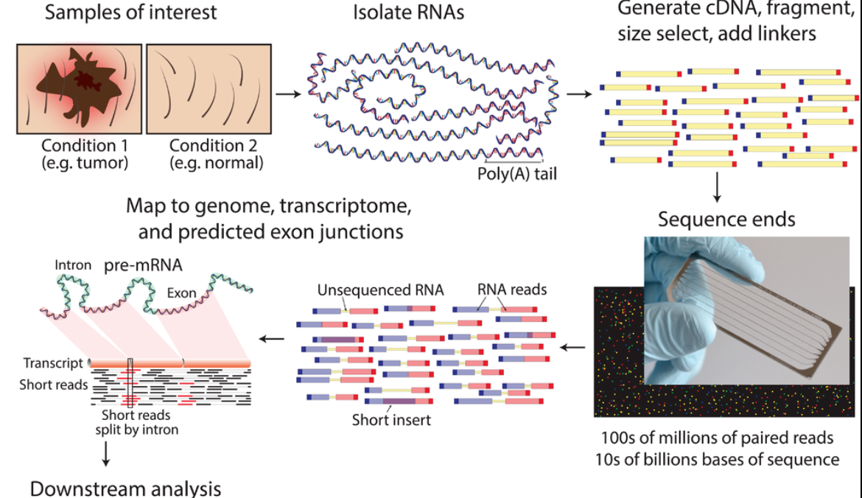
Typical RNA-seq protocol
mean length of 300 bp (typically ranging 200–700 bp
https://www.wikiwand.com/en/RNA-Seq

Slide 11
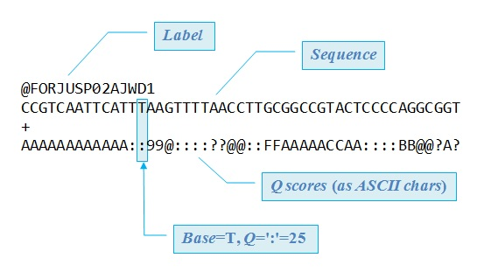
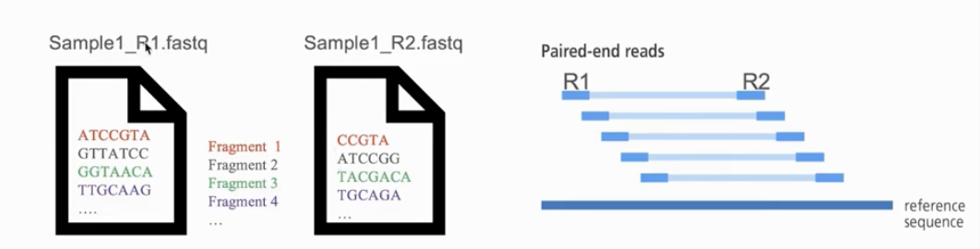
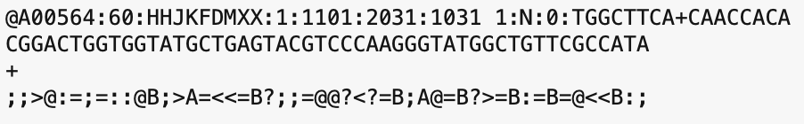
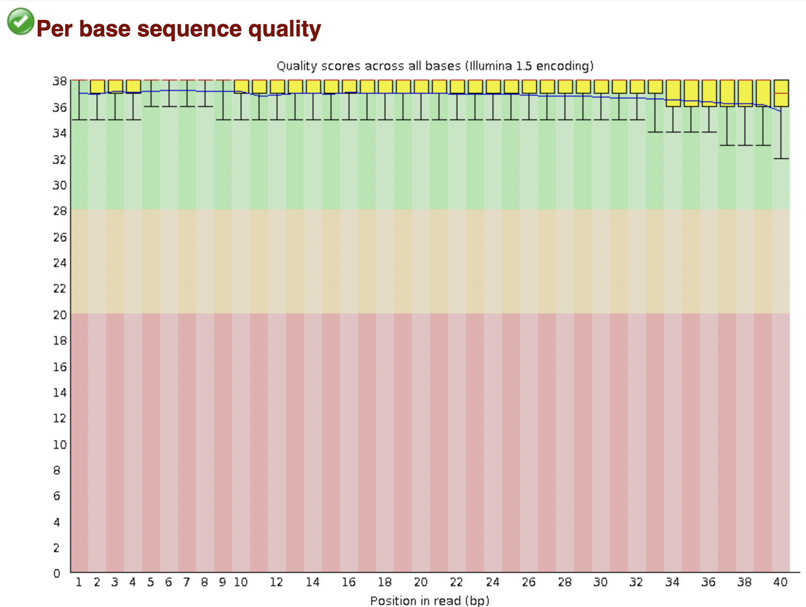
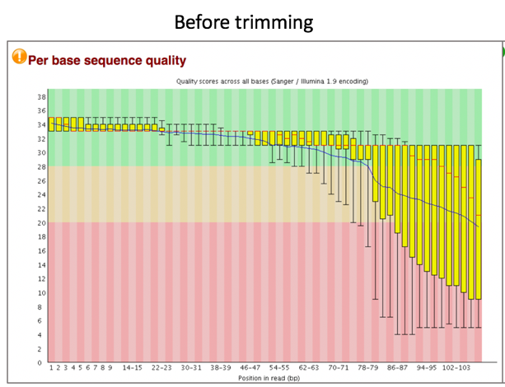
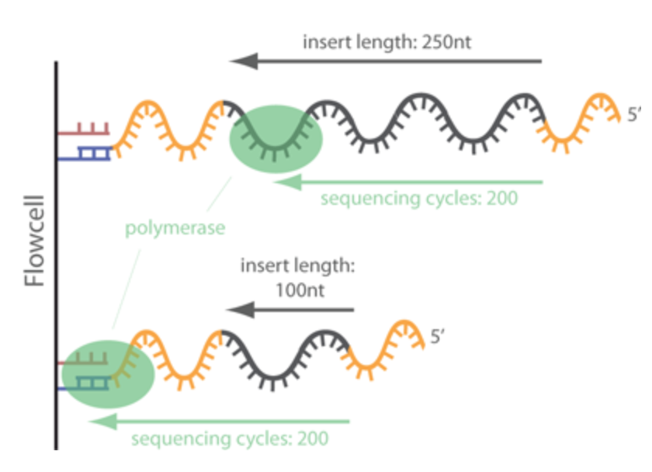
Bioinformatic pipeline - summary
FASTQ format
FASTQ file
FastQC - bad experiment needs trimming - cutadapt
FastQC - good experiment

Slide 12
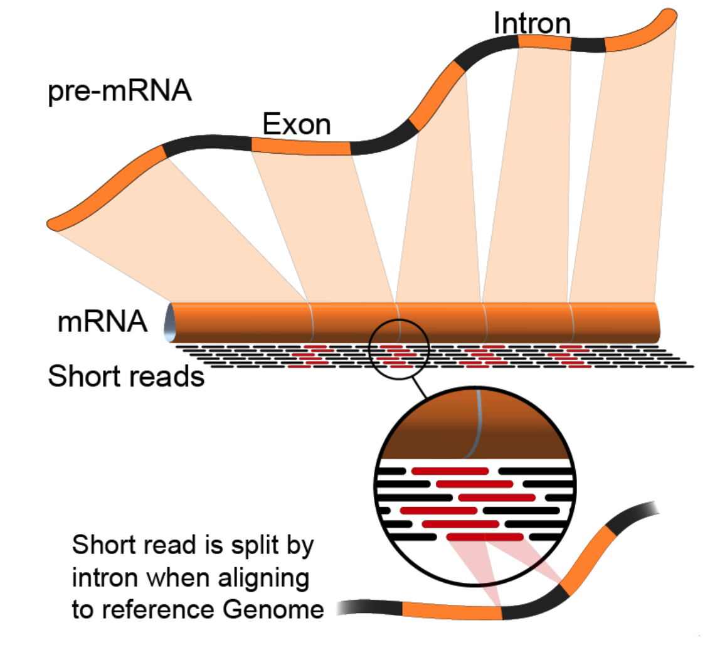
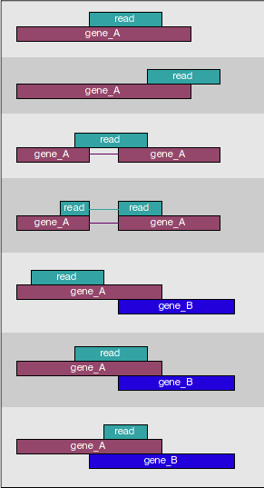
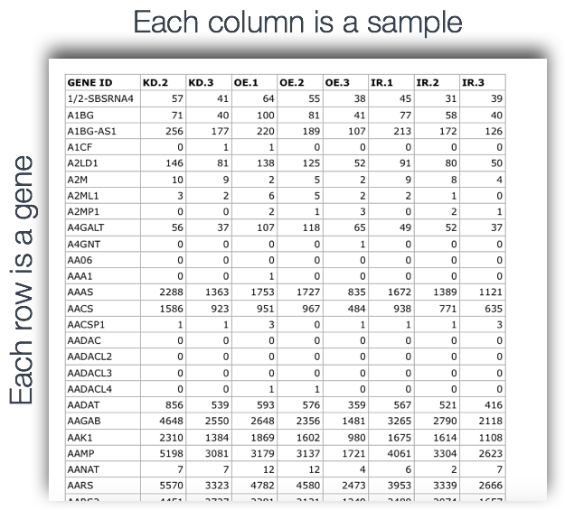
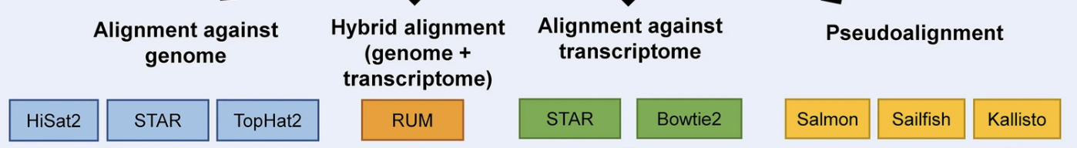
Bioinformatic pipeline - summary
Alignment and pseudo-alignment tools
Feature counts

Slide 13
Please find more details on our wiki page
Introduction-to-RNA-Seq-Analysis

Slide 14
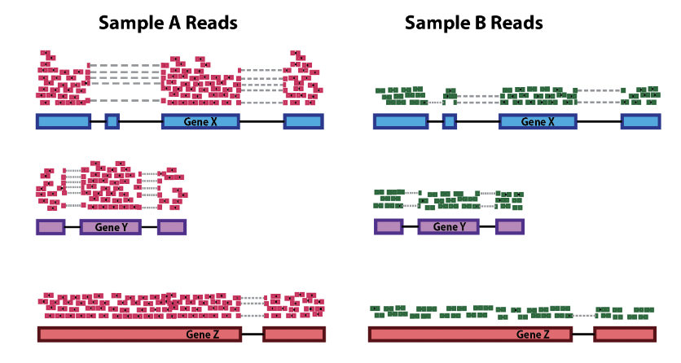
Many steps to calculate the Differentially Expressed Genes (DEG) between sample A and B
We need to make the counts comparable across samples

Slide 15
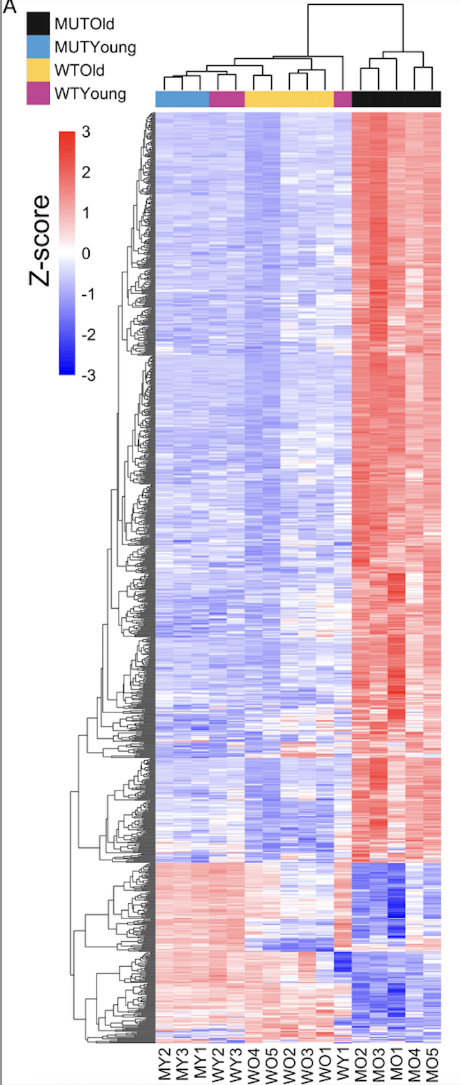
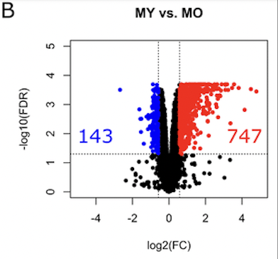
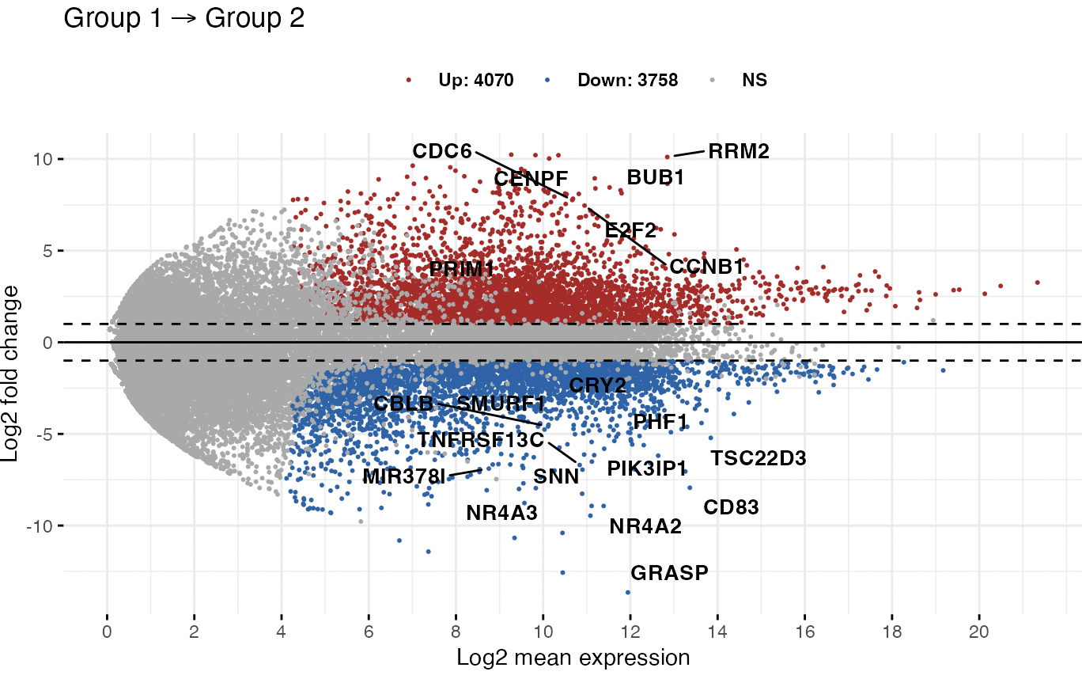
Goal of DEG analysis
Volcano plot
MA (mean-difference) plot
From Barham et al 2013
From Barham et al 2013
Heatmap
Identify genes (and molecular pathways) that are differentially expressed (DE) between two or more biological conditions
Notes:
Ma plot from https://rpkgs.datanovia.com/ggpubr/reference/ggmaplot.html
MA-plot is a scatter plot of log2 fold changes (M, on the y-axis) versus the average expression signal (A, on the x-axis). M = log2(x/y) and A = (log2(x) + log2(y))/2 = log2(xy)*1/2, where x and y are respectively the mean of the two groups being compared.

Slide 16
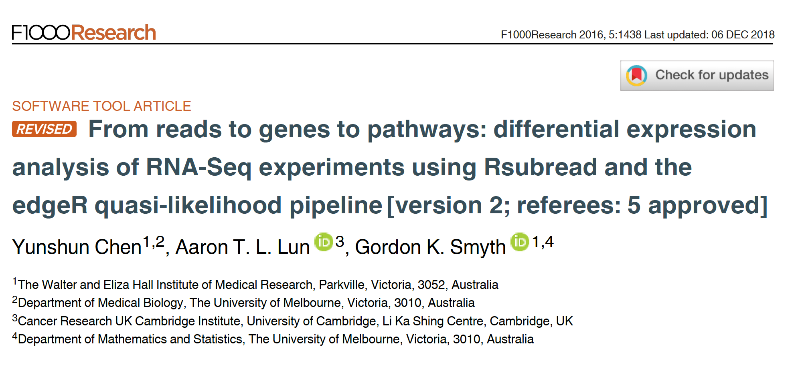
Reference for the workshop
Notes:
Relevant reading for theory:
1. Chen, Yunshun, Aaron TL Lun, and Gordon K. Smyth. "Differential expression analysis of complex RNA-seq experiments using edgeR." Statistical analysis of next generation sequencing data. Springer, Cham, 2014. 51-74.

Slide 17
Dataset
Transcriptome analysis of luminal and basal cell subpopulations in the lactating versus pregnant mammary gland
GEO (gene expression omnibus) accession: GSE60450
Tissue of origin: Mammary glands of mouse
Cell types: Basal stem-cell enriched cells (B) and committed luminal cells (L)
Biological conditions: Virgin, Lactating (2 day) and Pregnant (18.5 day)
# of groups: 2 cell types (B/L) x 3 conditions (V/L/P) = 6 groups
# of replicates: 2 of each group
Illumina Hiseq sequencer - about 30 million 100bp single-end reads for each sample.
https://www.ncbi.nlm.nih.gov/geo/

Slide 18
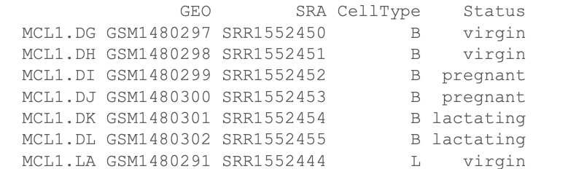
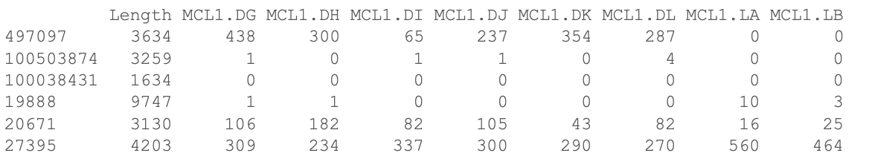
Files for the hands-on session
targets.txt
Phenofile
GSE60450_Lactation-GenewiseCounts.txt.gz
Counts for each sample for each gene (Entrez Gene Identifiers)

Slide 19
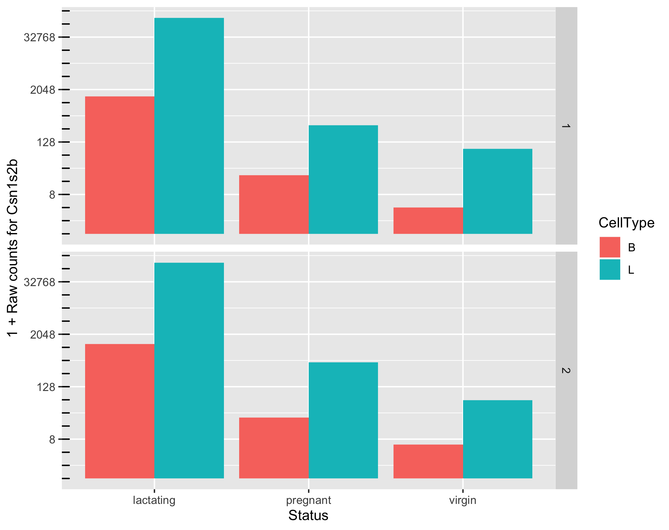
Potential biological questions
Which comparisons are we interested in?
Example:
B vs L,
B.lactating vs L.pregnant,
...
All of them
Or not interested in comparisons but in gene expression of one sample

Slide 20
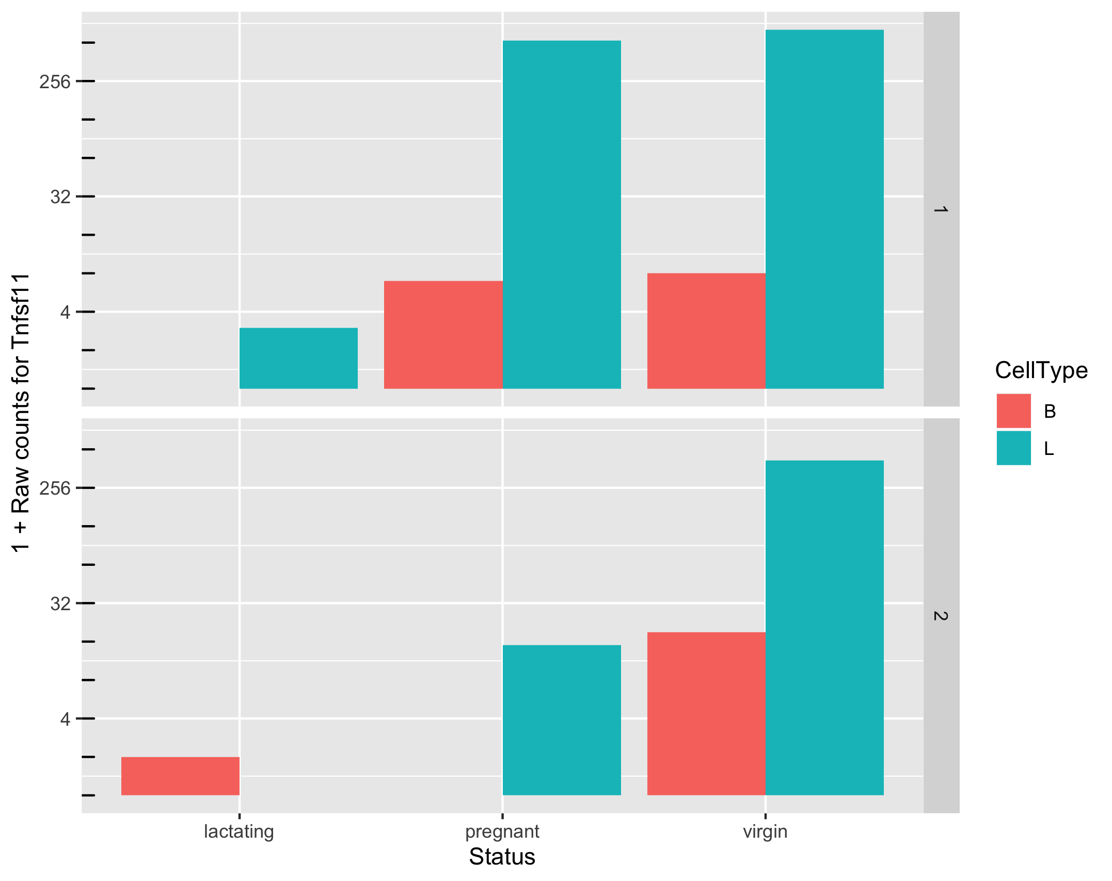
Potential issues
Can we make reliable inferences for genes with very low counts? What should we consider “very low”?

Slide 21
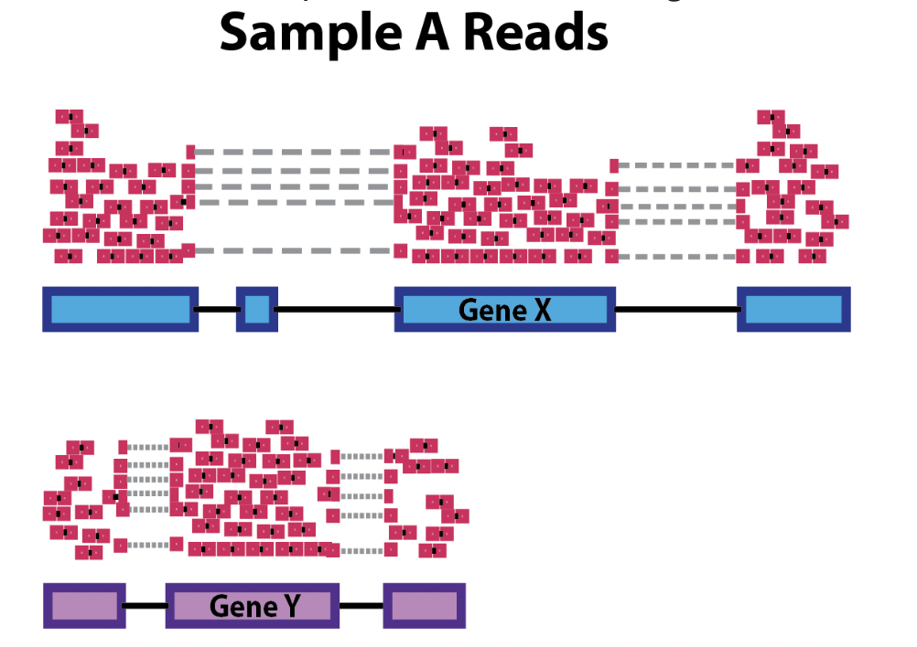
Possible analyses
Within a sample
Between samples
Estimate and compare gene expressions across genes (features)
DEG: Compare gene expressions across samples

Slide 22
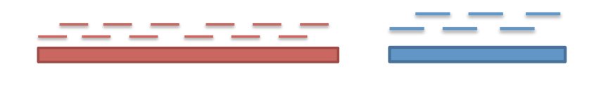
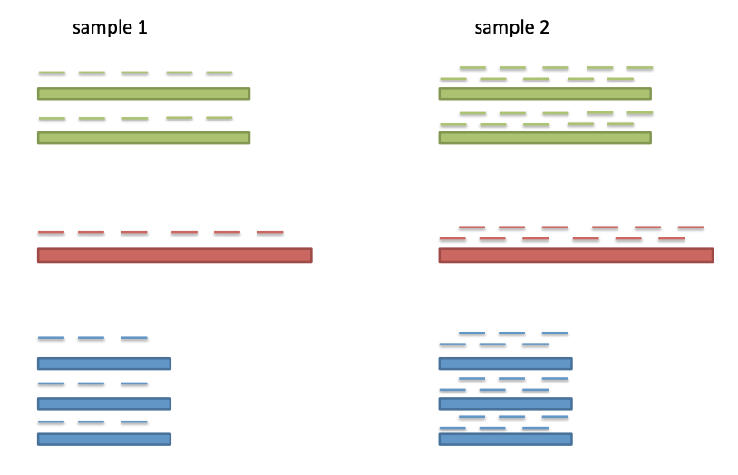
Bias: Gene-length and sequence depth
At the same expression level, a long gene will have more reads than a shorter gene
Higher sequencing depth, higher counts

Slide 23
Different sequence depths cause variation in counts
Variation in sequencing depths => Need to normalize counts
Group | Total counts
B.virgin | 23085177
B.virgin | 21628857
B.pregnant | 23919152
B.pregnant | 22490570
B.lactating | 21382233
B.lactating | 19884434
Group | Total counts
L.virgin | 20213223
L.virgin | 21509988
L.pregnant | 22073815
L.pregnant | 21837341
L.lactating | 24638939
L.lactating | 24581591
Library size about 20M

Slide 24
Source of technical variability
Identify and correct technical biases removing the least possible biological signal.
Gene length
Library size or sequence depth (number of mapped reads)
RNA sample composition
Batch effects
…

Slide 25
Poll 2
Within same sample gene expression quantification might be biased by:
Gene length
Sequencing depth
Both

Slide 26
Poll 3
Between samples differentially gene expression (DEG) might be biased by:
Gene length
Sequencing depth
Both

Slide 27
Several normalization methods to remove technical bias
Normalized expression are necessary to remove technical biases
Depth of sequencing correction
Depth of sequencing and gene length correction
RNA sample composition
To remove between samples batch effects
Various normalized gene expression units such as RPM (or CPM), RPKM, FPKM, TPM, TMM (edgeR), DESeq
Measure of the abundance of gene or transcripts.

Slide 28
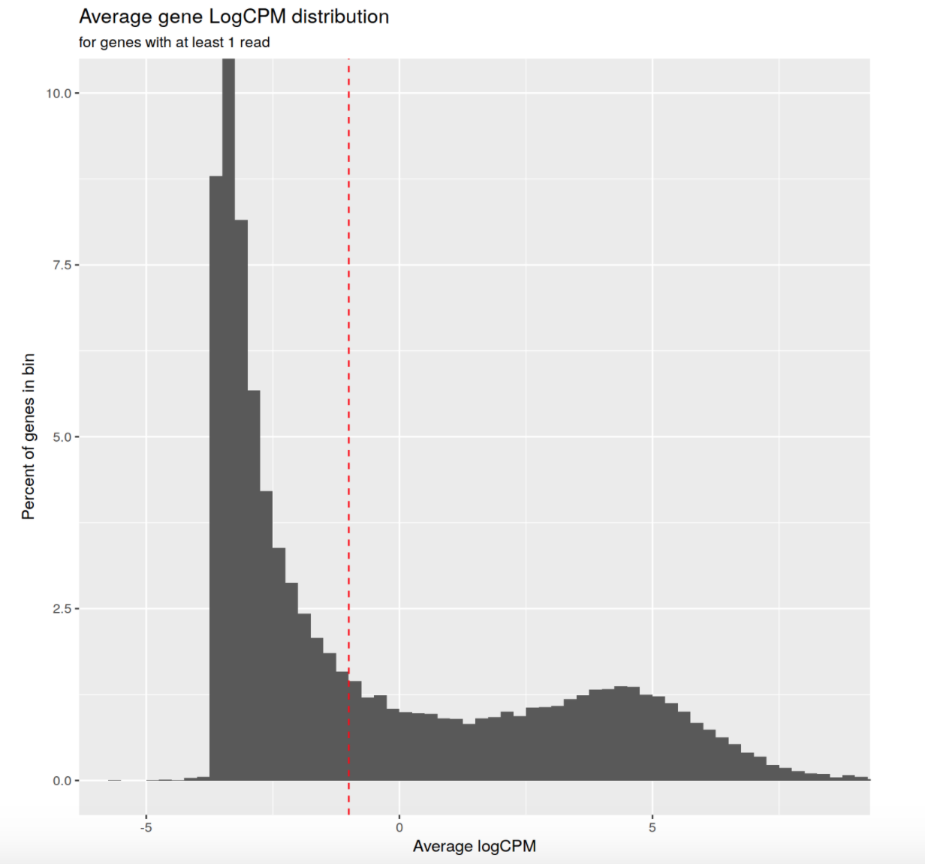
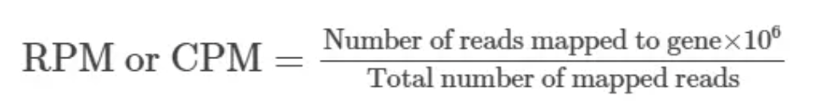
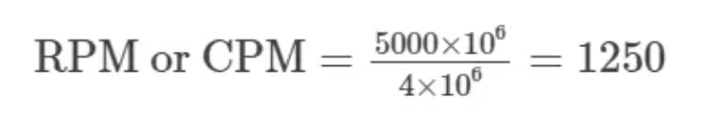
Sequence depth/Library size - Count Per Million mapped reads
Sequenced one library with 5 million(M) reads.
Total 4 M matched to the genome sequence
5000 reads matched to a given gene
Filter on count-per-million (CPM) values to avoid favoring genes that are expressed in larger libraries over those expressed in smaller libraries
A gene at least 10–15 counts in at least some libraries before it is considered to be expressed -> Identifying the CPM that corresponds to 10-15 counts
For comparison within replicates or same group, NOT for within sample, NOT for DEG

Slide 29
Common methods to normalize the counts considering gene length
Commonly used normalization method that includes sequence depth and gene length correction:
RPKM /FPKM (Reads/Fragments Per Kilobase per Million)
TPM (Transcripts Per kilobase Million)
Notes:
https://www.rna-seqblog.com/rpkm-fpkm-and-tpm-clearly-explained/

Slide 30
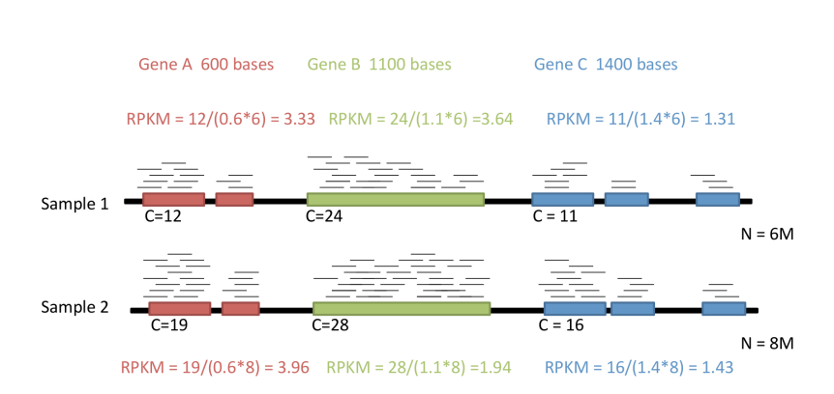
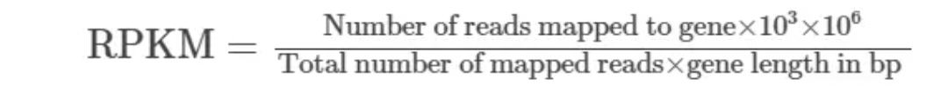
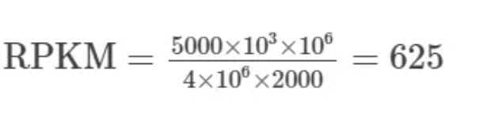
RPKM: seq depth and gene length bias
Reads/Fragments Per Kilobase per Million
One library with 5 M reads
Total 4 M matched to the genome sequence
5000 reads matched to a given gene with a length of 2000 bp.
RPKM and FPKM -> the sum of the normalized reads in each sample may be different, and this makes it harder to compare samples directly.
Notes:
https://www.rna-seqblog.com/rpkm-fpkm-and-tpm-clearly-explained/
RPKM:
Count up the total reads in a sample and divide that number by 1,000,000 – this is our “per million” scaling factor.
Divide the read counts by the “per million” scaling factor. This normalizes for sequencing depth, giving you reads per million (RPM)
Divide the RPM values by the length of the gene, in kilobases. This gives you RPKM.
FPKM is used especially for normalizing counts for paired-end RNA-seq data in which two (left and right) reads are sequenced from the same DNA fragment. Generally, the higher the FPKM of a gene, the higher the expression of that gene.

Slide 31
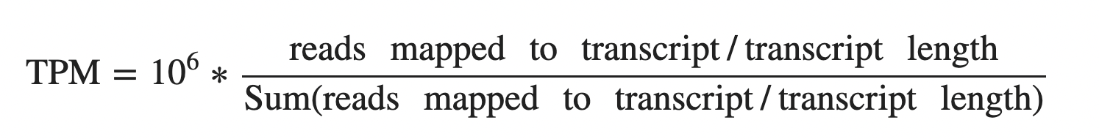
TPM: seq depth and gene length bias
TPM: Normalize for gene length first to get the Reads Per Kilobase, sum up all the RPK in a sample (across all genes), and then normalize for sequencing depth
Represent the relative abundance of a transcript among a population of sequenced transcripts
The sum of all TPMs in all samples are the same -> to compare the proportion of reads that mapped to a gene in each sample.
TPM is equal to 10⁶ (1 million) divided by the number of annotated transcripts in a given annotation so it is constant and proportional to the relative RNA molar concentration
Notes:
https://translational-medicine.biomedcentral.com/articles/10.1186/s12967-021-02936-w
https://www.biostars.org/p/273537/
https://www.ncbi.nlm.nih.gov/pmc/articles/PMC7373998/
TPM:
Divide the read counts by the length of each gene in kilobases. This gives you reads per kilobase (RPK).
Count up all the RPK values in a sample and divide this number by 1,000,000. This is your “per million” scaling factor.
Divide the RPK values by the “per million” scaling factor. This gives you TPM.

Slide 32
Don’t use these methods for between condition/groups comparison!
When total RNA composition is similar across samples, these methods could be potentially used.
But you can’t assume it!
Cells don’t necessarily produce similar levels of RNA/cell between cell types, disease states or developmental stages is not always valid

Slide 33
Methods for between samples comparisons / DEG

Slide 34
Observed counts depend on total reads sequenced and RNA sample composition
Sample-to-sample variability in total RNA concentration
Need to normalize for difference in total reads between samples.
Might be enough if total nucleic acid is the same in both samples.
Example: technical replicates
Need to account for difference in RNA sample composition

Slide 35
RNA composition -> scaling factors
Normalize for RNA composition differences by scaling factor
A few highly differentially expressed genes may have a strong influence on read counts -> minimizing effect of such genes
Assumption: A majority of transcripts is not differentially expressed
Adjust counts such that for most genes, counts are not differential.

Slide 36
Approach to identify DE genes: edgeR
Bioconductor package edgeR utilizes a theoretical model that captures some of the known processes leading to noise in counts data. (null model)
Assume that the data is generated according to this model.
Given any observed level of difference in mean expression levels of a gene, compute the probability that the observation will result from the null model (p value)
If the probability is very low (e.g., p < 0.05), infer that something may be happening that we did not account for in the null model. (e.g., biological processes in L cells for milk production)
Notes:
p-value is the probability of an observed (or more extreme) result assuming that the null hypothesis is true
For all the details see: http://bioconductor.org/packages/devel/bioc/vignettes/edgeR/inst/doc/edgeRUsersGuide.pdf

Slide 37
Need to correct for multiple testing
P value represents the chance that we may be wrong in calling something significantly differential. Example:
P = 0.01 means 1% chance that we may be wrong.
P = 0.50 means 50% chance that we may be wrong.
More than 20k genes under consideration
=> if a certain difference in expression levels has only 1% chance of happening given the null model, it
might be observed for 200 genes even if the null model were true for all the genes.
=> 200+ false positives
Hence, there is a need to adjust the p-values.
- The more genes we test, the more we must adjust.
- Reduce the number of tests by filtering out “uninteresting” genes.

Slide 38
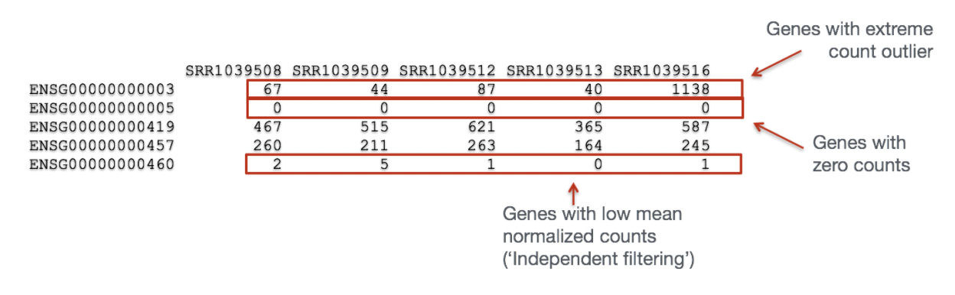
“Uninteresting” genes Filtering
Biological point of view: minimal expression level of a gene -> translation into a protein -> biologically relevant
Statistical point of view: low counts -> not enough statistical evidence.
Genes with consistently low counts are very unlikely be assessed as significantly DE

Slide 39
Between sample normalization
Normalize for RNA composition by a set of scaling factors that minimize the log-fold changes between the samples for most genes
Reference sample: have the closest average expressions to the mean of all samples
Test samples: other samples
Scaling factor: weighted mean of log ratios between the test and reference, from a gene set removing most/lowest expressed genes (avg read counts) and genes with highest/lowest log ratios (differences in expression)

Slide 40
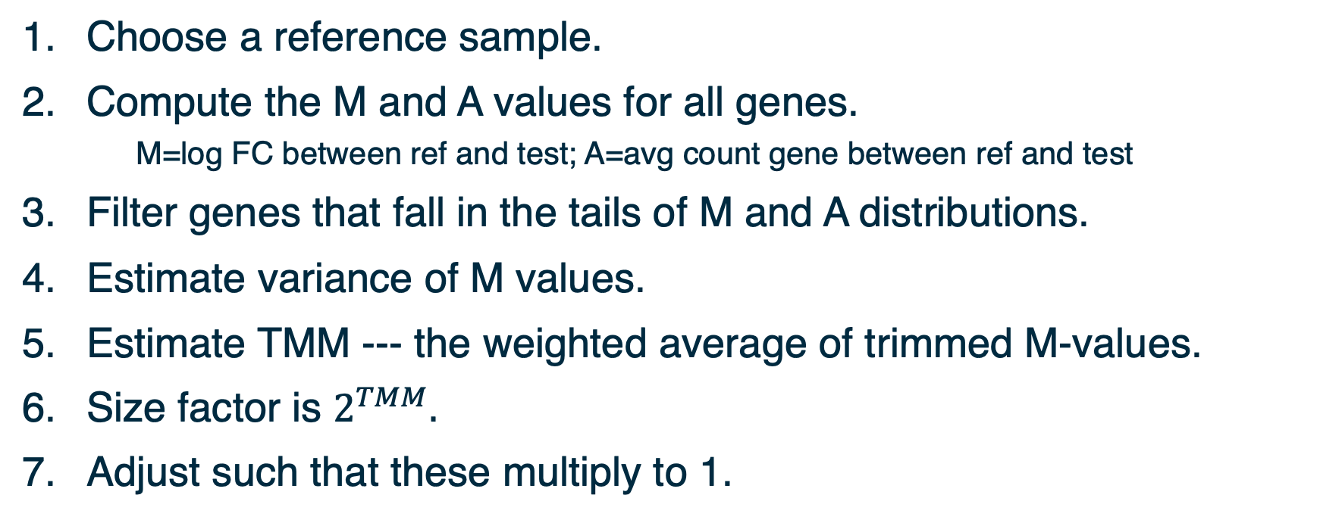
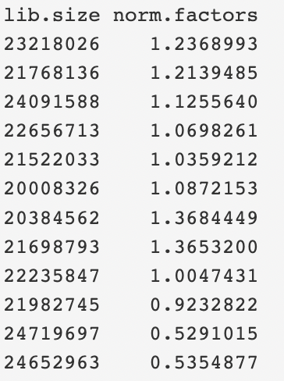
Normalization with edgeR: Trimmed Mean of M-values
TMM is implemented in edgeR and performs better for between-samples comparisons, when comparing the samples from different tissues or genotypes.
Notes:
Another approach is TMM˜[15], which measures the trimmed mean of M and A values (M values are the log fold change in the number of reads aligning to a region of interest measured relative to an average or arbitrary sample, A is the average count of a gene; the trimmed mean discards regions of interest that have extreme M or A values and calculates the mean M value of the remainder); the inverse of this mean is used to weight samples.
To see how the weights are calculated:
𝑀=log_2⁡(𝑋_2/𝑁_2 )−log_2⁡(𝑋_𝑟𝑒𝑓/𝑁_𝑟𝑒𝑓 )
⇒𝑉𝑎𝑟(𝑀)=𝑉𝑎𝑟_2+𝑉𝑎𝑟_𝑟𝑒𝑓, where 𝑉𝑎𝑟_𝑟𝑒𝑓=𝑉𝑎𝑟(log_2⁡(𝑋_𝑟𝑒𝑓/𝑁_𝑟𝑒𝑓 ) )
and 𝑉𝑎𝑟_2=𝑉𝑎𝑟(log_2⁡(𝑋_2/𝑁_2 ) ).
Assume 𝑁_2 and 𝑁_𝑟𝑒𝑓 are constant.
⇒𝑉𝑎𝑟_2=𝑉𝑎𝑟(log_2⁡(𝑋_2 ) )
and, 𝑉𝑎𝑟_𝑟𝑒𝑓=𝑉𝑎𝑟(log_2⁡(𝑋_𝑟𝑒𝑓 ) )
Note:
a. 𝑉𝑎𝑟(𝑋)=𝑋(1−𝑋/𝑁) if 𝑋 is binomially distributed.
b. In general, if 𝑌=𝑎𝑋, then 𝑉𝑎𝑟(𝑌)=𝑎^2 𝑉𝑎𝑟(𝑋).
c. The slope of log_2⁡〖(𝑥)〗 at some 𝑥_0 is proportional to 1/𝑥_0 .
⇒𝑉𝑎𝑟∝(1/𝑋)^2.𝑋(1−𝑋/𝑁)
=(𝑁−𝑋)/𝑁𝑋

Slide 41
Other approaches to normalization
Relative Log Expression (RLE) approach by Anders and Huber (2010)
Reference: geometric mean of all samples
Normalization factor: median ratio of each sample to the reference
RLE and TMM give similar results with real and simulated data
R package DESeq
Upper quartile normalization by Bullard et al (2010)
Normalization factor: 75% quantile of the counts for each sample
Not recommended in general
Control genes (housekeeping genes, spike-in) to estimate technical noise (RUVSeq – 2014 Remove Unwanted Variation)
Notes:
More about normalization methods: https://bmcgenomics.biomedcentral.com/articles/10.1186/s12864-020-6502-7
Relative Log Expression - Anders, S, Huber, W (2010). Differential expression analysis for sequence count data. Genome Biology 11, R106.
Bullard JH, Purdom E, Hansen KD, Dudoit S. (2010) Evaluation of statistical methods for normalization and differential expression in mRNA-Seq experiments. BMC Bioinformatics 11, 94.
RUVSeq https://bioconductor.org/packages/devel/bioc/manuals/RUVSeq/man/RUVSeq.pdf

Slide 42
Best practice to choose a normalization
An effective normalization should result in a stabilization of read counts across samples (eliminate composition biases between libraries)
TC, RPKM, UQ - Adjustment of distributions, implies a similarity between RNA repertoires expressed
DESeq, TMM - More robust ratio of counts using several samples, suppose that the majority of the genes are not DE
RUVSeq - Powerful when a large set of control genes can be identified
Notes:
Suggested:
Selecting between-sample RNA-Seq normalization methods from the perspective of their assumptions: https://www.ncbi.nlm.nih.gov/pmc/articles/PMC6171491/
A comprehensive evaluation of normalization methods for Illumina high-throughput RNA sequencing data analysis : https://academic.oup.com/bib/article/14/6/671/189645?login=false

Slide 43
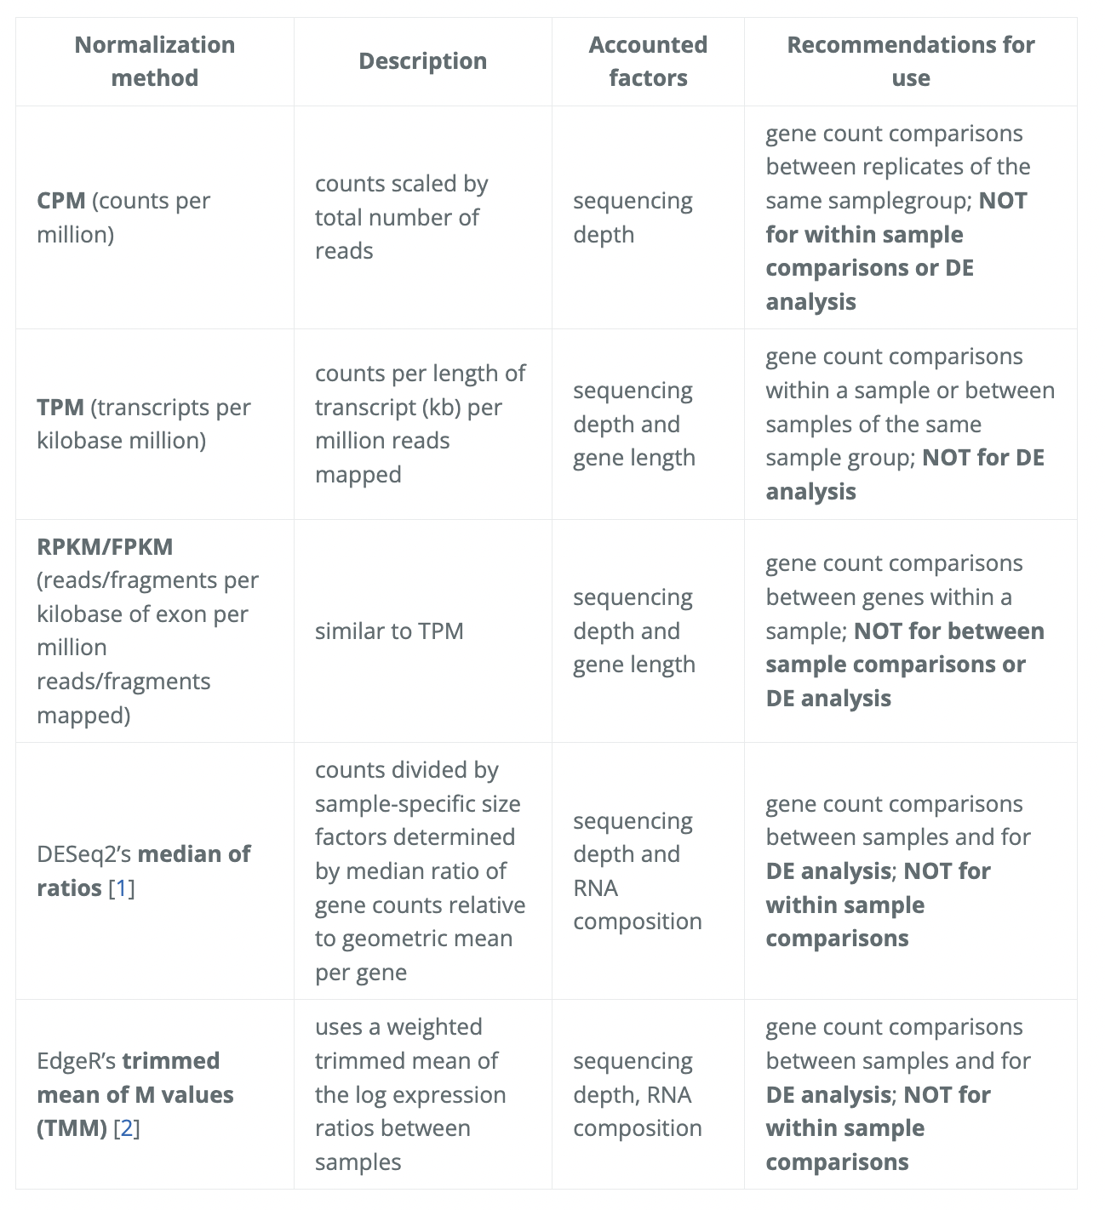
Main normalization approaches summary
https://hbctraining.github.io/Training-modules/planning_successful_rnaseq/lessons/sample_level_QC.html

Slide 44
Break (10 min)
Demo I
Notes:
For multidimensional scaling and PCA:
Look up Ali Ghodsi’s lectures on youtube.

Slide 45
Knowledge check 2 - Poll 4
Which normalization is suitable for within-sample gene expression quantification:
TPM
TMM (edgeR)
Within a sample
Notes:
For multidimensional scaling and PCA:
Look up Ali Ghodsi’s lectures on youtube.

Slide 46
Knowledge check - Poll 5
Which normalization is suitable for comparing gene expression between disease samples vs control samples
RPKM
TMM (edgeR)
Notes:
For multidimensional scaling and PCA:
Look up Ali Ghodsi’s lectures on youtube.

Slide 47
Demo I

Slide 48
Hands-on session
Load and reformat the data
Exploratory visualization : MA plot
Create DGElist object and retrieve gene symbols
Filter genes with inadequate information
Exploratory visualization : MDS and PCA plots
Define and fit a model
Hypothesis testing (four example hypotheses)
Save results as a table and explore in Excel

Slide 49
Dataset
Transcriptome analysis of luminal and basal cell subpopulations in the lactating versus pregnant mammary gland
GEO (gene expression omnibus) accession: GSE60450
Tissue of origin: Mammary glands of mouse
Cell types: Basal stem-cell enriched cells (B) and committed luminal cells (L)
Biological conditions: Virgin, Lactating (2 day) and Pregnant (18.5 day)
# of groups: 2 cell types (B/L) x 3 conditions (V/L/P) = 6 groups
# of replicates: 2 of each group
Illumina Hiseq sequencer - about 30 million 100bp single-end reads for each sample.
https://www.ncbi.nlm.nih.gov/geo/

Slide 50
MDS and PCA plots
Notes:
For multidimensional scaling and PCA:
Look up Ali Ghodsi’s lectures on youtube.

Slide 51
Assessing overall similarity across samples
Which samples are similar to each other, which are different?
Does this fit to the expectation from the experiment’s design?
What are the major sources of variation in the dataset?

Slide 52
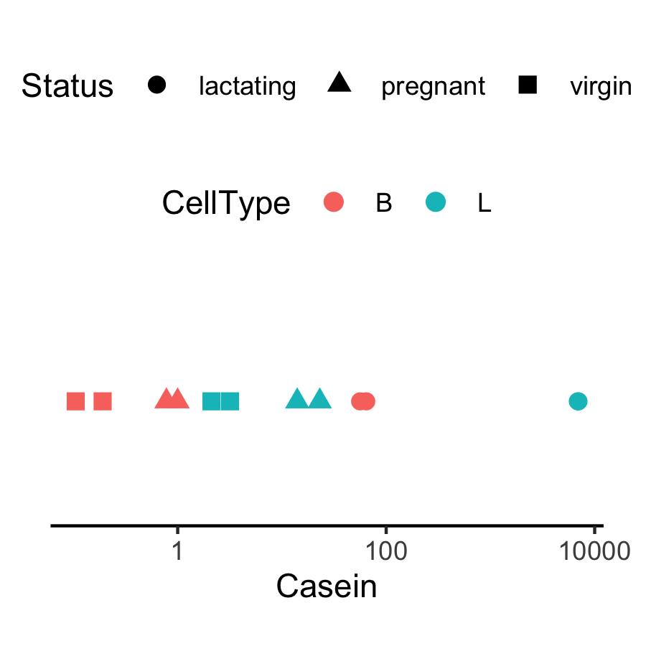
Expression level of Casein varies in a way that is strongly indicative of the effect of CellType and Status.
Why are the B.lactating samples not close to B.virgin and B.pregnant samples?
Could it be due to batch effects?
The distance between each pair of samples can be interpreted as the leading log-fold change between the samples for the genes that best distinguish that pair of samples.

Slide 53
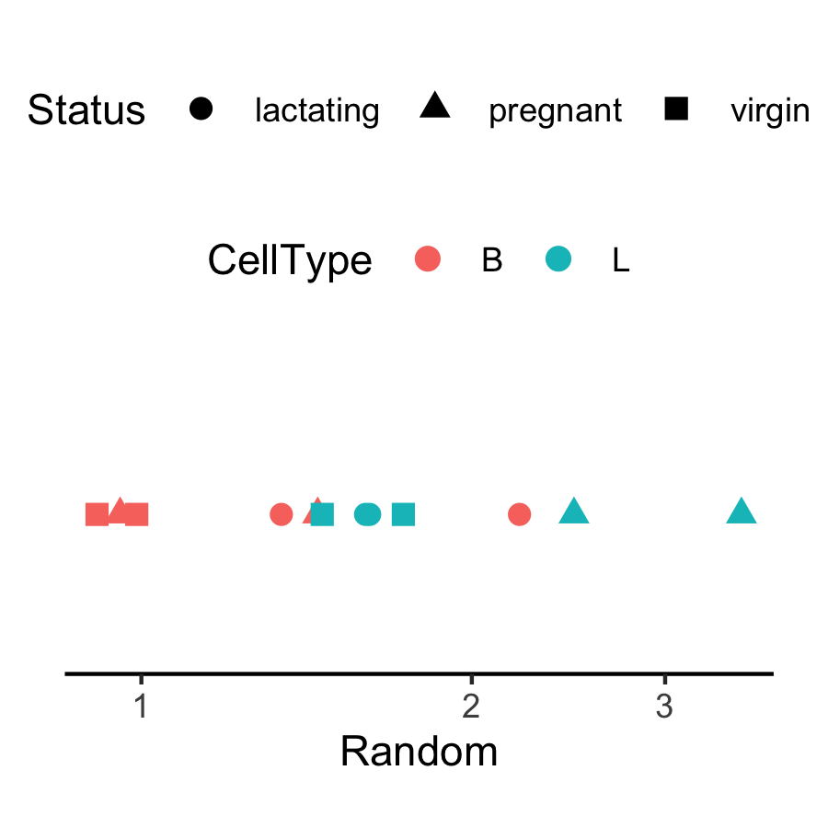
Expression appears to vary across samples but…
In general, the way expression appears to vary across samples could be dominated by noise, batch effects, real signal, etc.
Identify the source fof technical variability!

Slide 54
Fitting the model

Slide 55
How to model the normalized RNA-seq red counts
Total number of reads for a sample ~ millions
Counts per gene ~ tens /hundreds /thousands.
The chance of a given read to be mapped to any specific gene is rather small.
Discrete events sampled out of a large pool with low probability are usually modeled with Poisson distribution

Slide 56
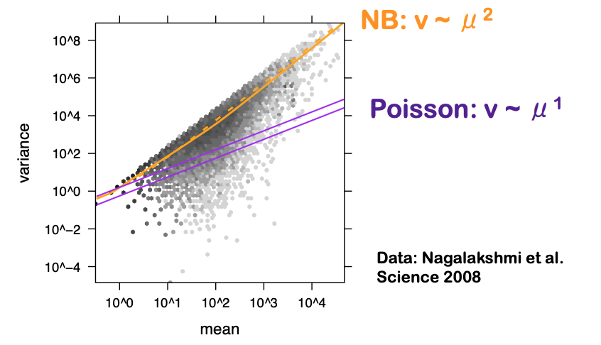
Overdispersion of read counts between samples
The number of reads that are mapped into a gene was first modeled using a Poisson distribution
Assumption: assumes that mean and variance are the same
The variance grows faster than the mean in RNAseq data.
Pooled gene-level variance
Mean gene expression level
Overdispersion in RNA-seq data
-> counts from biological replicates vary so tend to have variance exceeding the mean (highly expressed genes)
-> underestimation of the biological variance increased the probability to falsely declare a gene DE when it is non-DE (type I error rate)

Slide 57
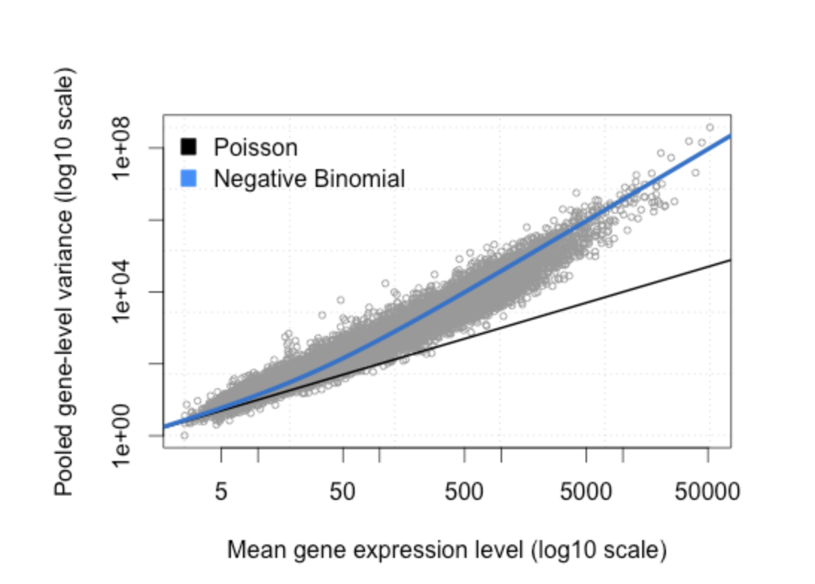
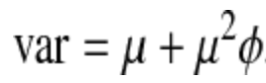
Three dispersion estimates
The negative binomial (NB) distribution proposed as an alternative to model the read counts for each gene in each sample
The variance is always larger than the mean for the negative binomial ⇒ suitable for RNA-seq data
Many genes, few biological samples - difficult to estimate φ on a gene-by-gene basis
Using information across all genes for stable estimates of φ.
Notes:
Phi is the variation of a gene’s expression relative to its mean

Slide 58
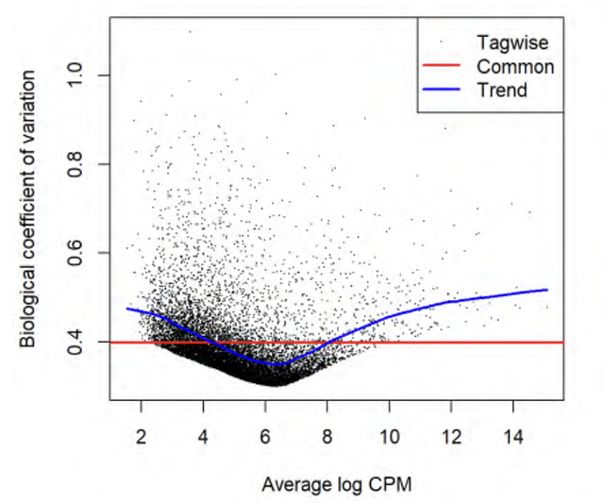
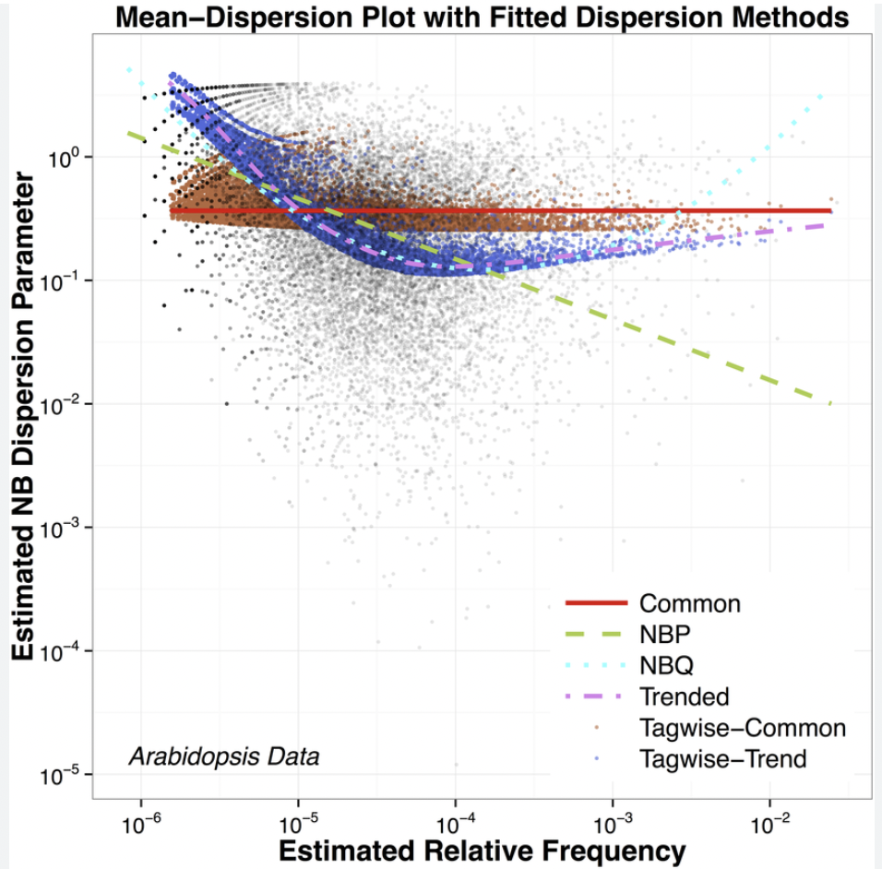
Empirical Bayes estimates of dispersion parameters: Learning from the experience of others
Dispersion accounts for variability between biological replicates
Common dispersion: a global dispersion estimate averaged across the genes – not enough
Trended dispersion: dispersion of a gene is predicted from its abundance – similar abundant genes
Tagwise dispersion: measure of the degree of consistent inter-library variation for that tag
Empirical Bayes estimates need to be controlled for the possibility of outlier genes with exceptionally large or small individual dispersions (robust=TRUE)
plotBCV (biological coeff variation)
Notes:
plotBCV() plots the tagwise biological coefficient of variation (square root of dispersions) against log2-CPM.
https://smartech.gatech.edu/bitstream/handle/1853/35125/efron_videostream.html?sequence=8&isAllowed=y
Robbins, Herbert. An Empirical Bayes Approach to Statistics. Proceedings of the Third Berkeley Symposium on Mathematical Statistics and Probability, Volume 1: Contributions to the Theory of Statistics, 157--163, University of California Press, Berkeley, Calif., 1956. https://projecteuclid.org/euclid.bsmsp/1200501653
http://seqanswers.com/forums/showthread.php?t=5591
See other example of tagwise dispersion DOI:10.1371/journal.pone.0119254

Slide 59
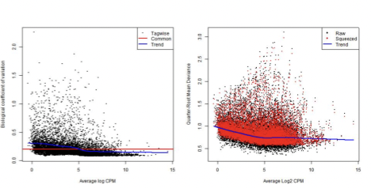
Fitting the model : glmQLFit to manage the variance of gene counts
NB dispersions - higher for genes with very low counts and decrease smoothly with abundance and asymptotically to a constant value for genes with larger counts.
Extended NB model to account for gene-specific variability from both biological and technical sources (quasi-likelihood)
NB dispersion trend is used to describe the overall biological variability across all genes (fit GLM)
For each gene-specific variability above and below the overall level (deviance) is picked up by the QL dispersion

Slide 60
edgeR fitting models
Classic (pairwise comparisons between two or more groups), glm and glmQL
QL for bulk RNA-seq:
+ stricter error rate control (more rigorous dispersion and uncertainty)
+ speed improvement compared to other quasi-methods
+ appropriate for multiple treatment factors and with small # of biological replicates
+ relative changes in expression levels between conditions (not absolute)
Limma package for large scale datasets – high overlap across methods
Notes:
https://www.bioconductor.org/packages/release/bioc/vignettes/edgeR/inst/doc/edgeRUsersGuide.pdf
Quasi likelihood https://pubmed.ncbi.nlm.nih.gov/23104842/
About limma /edgeR / Deseq2 differenceS: chrome-extension://efaidnbmnnnibpcajpcglclefindmkaj/https://www.e3s-conferences.org/articles/e3sconf/pdf/2021/47/e3sconf_icepe2021_03058.pdf

Slide 61
Get the DE genes - glmQLFTest
Identifies differential expression based on statistical significance regardless of how small the difference might be -> 5000 DE genes between condition and control groups
Interested only in genes with large expression changes -> subset of genes more biologically meaningful.
Modify the statistical test to evaluate variability as well as the magnitude of change of expression values -> expression changes greater than a specified threshold
Not equivalent to a simple fold change cutoff : “the fold-change below which we are definitely not interested in the gene”
The total number of DE genes identified at an FDR of 5% can be shown with decideTestsDGE() – set cutoff

Slide 62
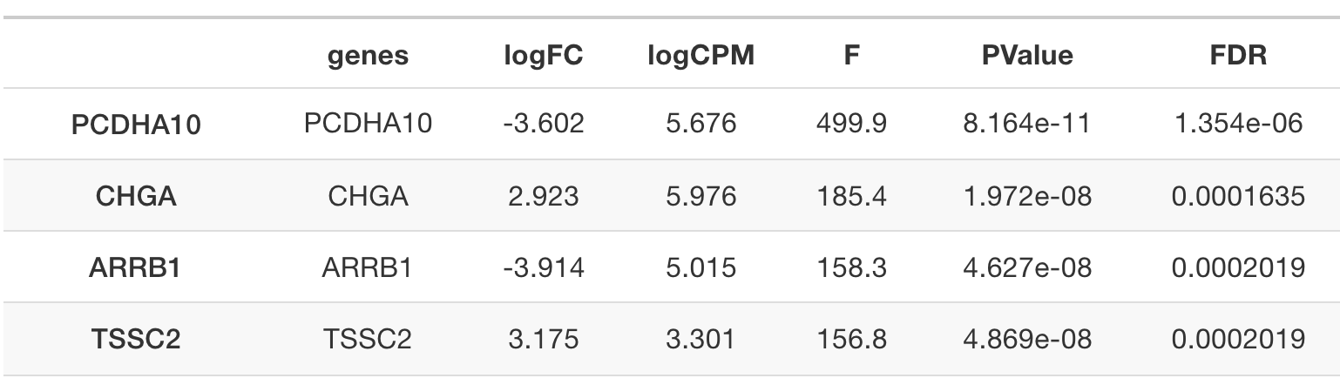
Get the DE genes - glmQLFTest
Complicated contrasts - makeContrasts()
- between lactating and pregnant mice is the same for basal cells as it is for luminal cells
- the interaction effect between mouse status and cell type

Slide 63
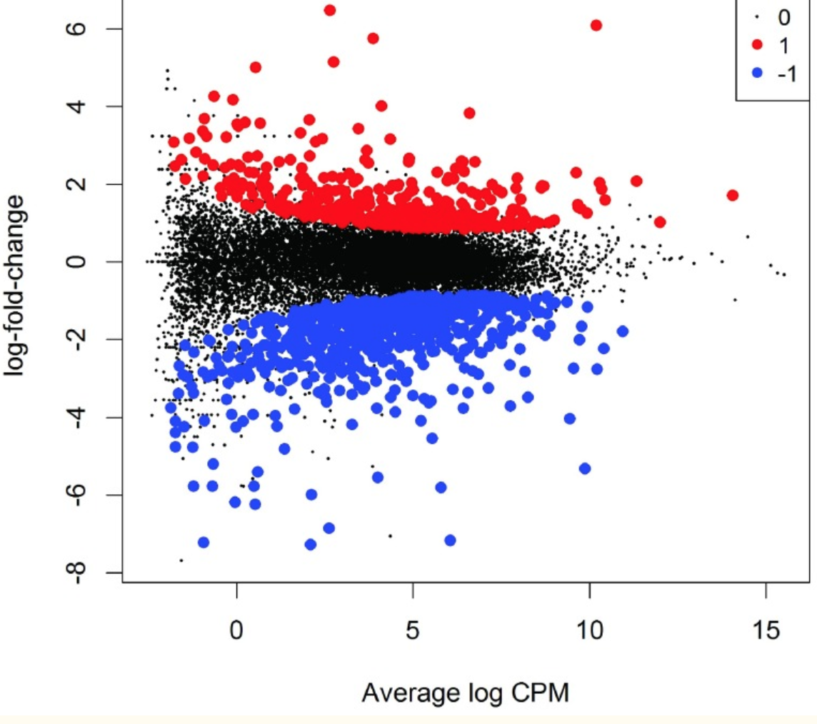
MD plot: Over and under expressed genes
Library size-adjusted log-fold change between two libraries (the difference) vs the average
log-expression across those libraries (the mean).
Log-fold change and average abundance of each gene

Slide 64
In summary
Raw counts are not comparable across samples/genes within a sample
Several normalization methods: some more suitable for DEG
Estimate the dispersion, visualize the technical variability
Fit the model: counts variance exceeding the mean
Make all the comparisons that you wish using complex contrast
Visualize the DEG and get a list for pathway analysis

Slide 65
Your feedback is important to us!
At the end of the hands-on session:
Please take the survey ~3 min:
https://www.surveymonkey.com/r/F75J6VZ
Real data might need additional analyses choices that need experience.
Consult with the Gladstone Bioinformatics core for such scenarios and data.

Slide 66
Demo II

Slide 67
Hands-on session
Load and reformat the data
Exploratory visualization : MA plot
Create DGElist object and retrieve gene symbols
Filter genes with inadequate information
Exploratory visualization : MDS and PCA plots
Define and fit a model
Hypothesis testing (four example hypotheses)
Save results as a table and explore in Excel

Slide 68
Upcoming workshop at Gladstone:
Oct 3 | Machine Learning for biologists - register
Oct 9-10 | Linear mixed effects models - register
Oct 16-17 | Single Cell RNA-seq (3 sessions)- register
Oct 31 | Introduction to pathway analysis - register
Winter workshops schedule coming soon - Data Science Training Program

Slide 69
Thank you!

Slide 70


